Slide 1


Blood Donation Management System Database
Tianzhu Li, Kai Sun, ShouTzu Han August 10, 2022

Slide 2
Overview
In real life, blood donation services are provided by local blood banks, so there may be some problems, such as insufficient blood storage for local patients.
For example, in some emergency, such as car accident, it is very dangerous if the patient cannot get enough blood immediately. Thus, an effective blood supply is an important consideration for blood donation organization.
In order to solve this problem for blood shortage ‘s region, we design a database for blood organizations around the country.
All blood donation organizations have access to the system to collect blood and delivered blood to hospitals, and if there is not enough blood for patients in local blood bank, the blood organization can immediately access the system to find a nearest blood bank from another location to address the blood shortage.

Slide 3
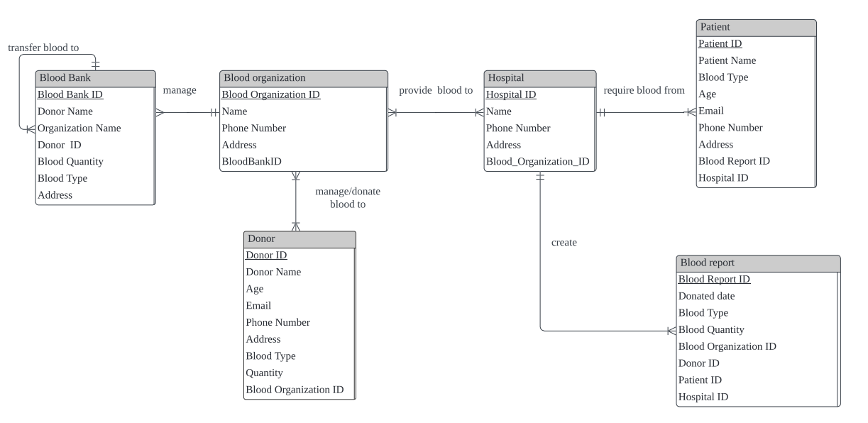
ERD

Slide 4
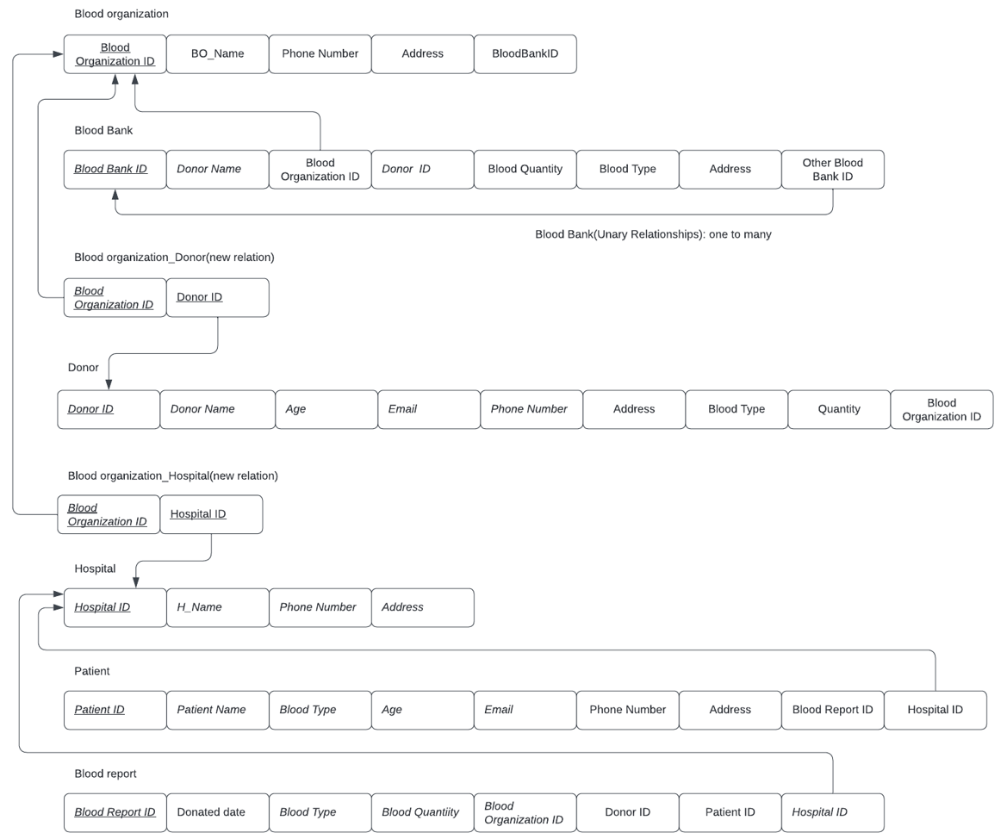
Logical Design

Slide 5
Physical Design and Tables
hello hello

Slide 6
Blood Organization Table
CREATE TABLE Blood_Organization (Blood_Organization_ID INT NOT NULL, Blood_Organization_Name VARCHAR (255), Phone_Number INT, Blood_Organization_Address VARCHAR(255), Blood_Bank_ID INT,CONSTRAINT fk0 foreign key (Blood_Bank_ID) references Blood_Bank(Blood_Bank_ID),CONSTRAINT Blood_Organization_PK PRIMARY KEY (Blood_Organization_ID));
FIELD NAME | TYPE | LENGTH | DECIMALS | INTEGRITY CONSTRAINTS
Blood_Organization_ID | INT |  |  | Primary Key
Blood_Organization_Name | VARCHAR | 255
Phone_Number | INT
Blood_Organization_Address | VARCHAR | 255
BloodBankID | INT |  |  | Foreign Key

Slide 7
Blood Bank Table
CREATE TABLE Blood_Bank (Blood_Bank_ID INT NOT NULL, Donor_Name VARCHAR (255), Blood_Organization_Name VARCHAR (255), Donor_ID INT, Blood_Quantity INT, Blood_Type VARCHAR (255), Blood_Bank_Address VARCHAR (255),CONSTRAINT Blood_Bank_PK PRIMARY KEY (Blood_Bank_ID));
Field Name | Type | Length | Decimals | Integrity Constraints
Blood_Bank_ID | INT |  |  | Primary Key
Donor_Name | VARCHAR | 255
Blood_Organization_Name | VARCHAR | 255
Donor_ID | INT
Blood_Quantity | INT
Blood_Type | VARCHAR | 255
Blood_Bank_Address | VARCHAR | 255

Slide 8
Donor Table
CREATE TABLE Donor (Donor_ID INT NOT NULL, Donor_Name VARCHAR (255), Age INT, Email VARCHAR(255), Blood_Quantity INT, Blood_Type VARCHAR (255), Blood_Organization_ID INT, Donor_Address varchar(255),CONSTRAINT fk1 foreign key (Blood_Organization_ID) references Blood_Organization(Blood_Organization_ID),CONSTRAINT Donor_PK PRIMARY KEY (Donor_ID));
Field Name | Type | Length | Decimals | Integrity Constraints
Donor_ID | INT |  |  | Primary Key
Donor_Name | VARCHAR | 255
Age | INT
Email | VARCHAR | 255
Donor_Address | VARCHAR | 255
Blood_Quantity | INT
Blood_Type | VARCHAR | 255
Blood_Organization_ID | INT |  |  | Foreign Key

Slide 9
Hospital Table
CREATE TABLE Hospital (Hospital_ID INT NOT NULL, Hospital_Name VARCHAR (255), Phone_Number INT, Hospital_Address VARCHAR(255), Blood_Organization_ID INT,CONSTRAINT fk2 foreign key (Blood_Organization_ID) references Blood_Organization(Blood_Organization_ID),CONSTRAINT Hospital_PK PRIMARY KEY (Hospital_ID));
Field Name | Type | Length | Decimals | Integrity Constraints
Hospital_ID | INT |  |  | Primary Key
Hospital_Name | VARCHAR | 255
Phone_Number | INT
Hospital_Address | VARCHAR | 255
Blood_Organization_ID | INT |  |  | Foreign Key

Slide 10
Patient Table
CREATE TABLE Patient (Patient_ID INT NOT NULL, Patient_Name VARCHAR (255), Blood_Type VARCHAR (255), Age INT, Email VARCHAR (255), Phone_Number INT, Patient_Address VARCHAR(255), Blood_Report_ID INT, Hospital_ID INT, CONSTRAINT fk3 foreign key (Hospital_ID) references Hospital(Hospital_ID),CONSTRAINT Patient__PK PRIMARY KEY (Patient_ID));
Field Name | Type | Length | Decimals | Integrity Constraints
Patient_ID | INT |  |  | Primary Key
Patient_Name | VARCHAR | 255
Blood_Type | VARCHAR | 255
Age | INT
Email | VARCHAR | 255
Phone_Number | INT
Patient_Address | VARCHAR | 255
Blood_Report_ID | INT
Hospital_ID | INT |  |  | Foreign Key

Slide 11
Blood Report Table
CREATE TABLE Blood_Report (Blood_Report_ID INT NOT NULL, Donated_Date DATETIME, Blood_Type VARCHAR (255), Blood_Quantity INT, Blood_Organization_ID INT, Donor_ID INT, Patient_ID INT, Hospital_ID INT,CONSTRAINT fk4 foreign key (Hospital_ID) references Hospital(Hospital_ID),CONSTRAINT Blood_Report__PK PRIMARY KEY (Blood_Report_ID));
Field Name | Type | Length | Decimals | Integrity Constraints
Blood_Report_ID | INT |  |  | Primary Key
Donated_Date | DATETIME
Blood_Type | VARCHAR | 255
Blood_Quantity | INT
Blood_Organization_ID | INT
Donor_ID | INT
Patient_ID | INT
Hospital_ID | INT |  |  | Foreign Key

Slide 12
Example Queries

Slide 13
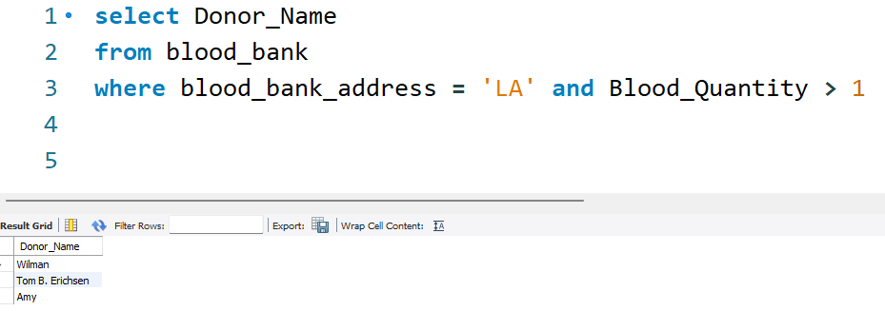
Query 1
Notes:
Who are the donors that donated blood at LA’ blood bank and it is still in stock.

Slide 14
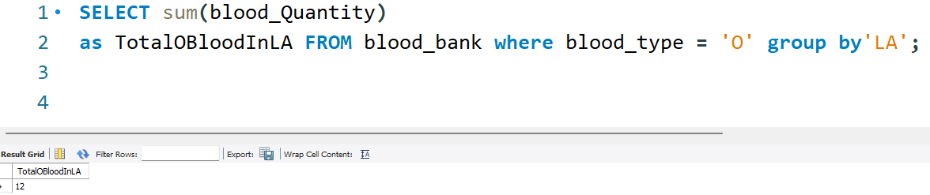
Query 2
Notes:
How many blood(type O) do we have in LA?

Slide 15
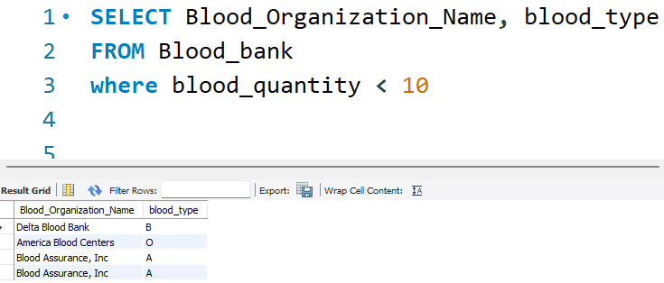
Query 3
Notes:
Show all the blood organizations with blood types that have blood quantity less than 10.

Slide 16
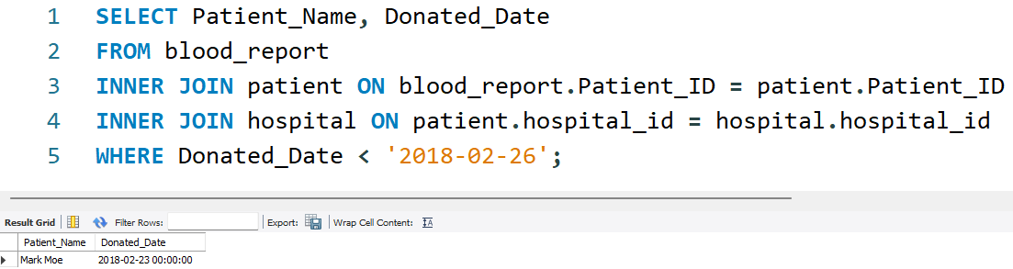
Query 4
Notes:
Who are the patients that received blood donation before 2018-02-26?

Slide 17
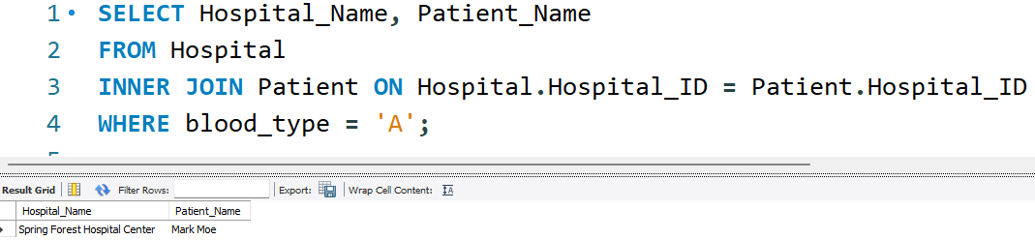
Query 5
Notes:
Show the patients in his/her hospital whose blood type is A.

Slide 18
Conclusion

Slide 19
1. What our learned
We learned how to design a database from start to finish, such as creating an erd, logical design, and physical design.
What I found out interesting is that we can create entities relationships by analyzing requirements from the real blood donation system.
And the most challenging part is drawing the relationship table for logical design because we need to consider if there is an association between 2 entities in a many-to-many relationship, then we need to create the new table to represent this relationship.

Slide 20
2. What you would do differently if you could start over
If we can start over, we will add a blood testing organization to provide a screening of blood donors, because not every blood donor is eligible to donate blood. Some blood donors may have diseases, so their blood is also not healthy. This is not considered in our project. If we can start over, we will add a blood testing organization between the blood organization and the donor.

Slide 21
3. Changes to the project along the way
We initially wanted to design a platform in which hospitals could communicate with blood donation agencies about the blood type they needed, and patients could communicate with hospitals here. But we found it inconvenient for us to explain some of the relationships, such as the relationship between blood bank and blood organization. So we decided to cancel the design of the platform, and instead let the two roles that have a relationship with each other be connected individually.

Slide 22
The End

